Slide 1

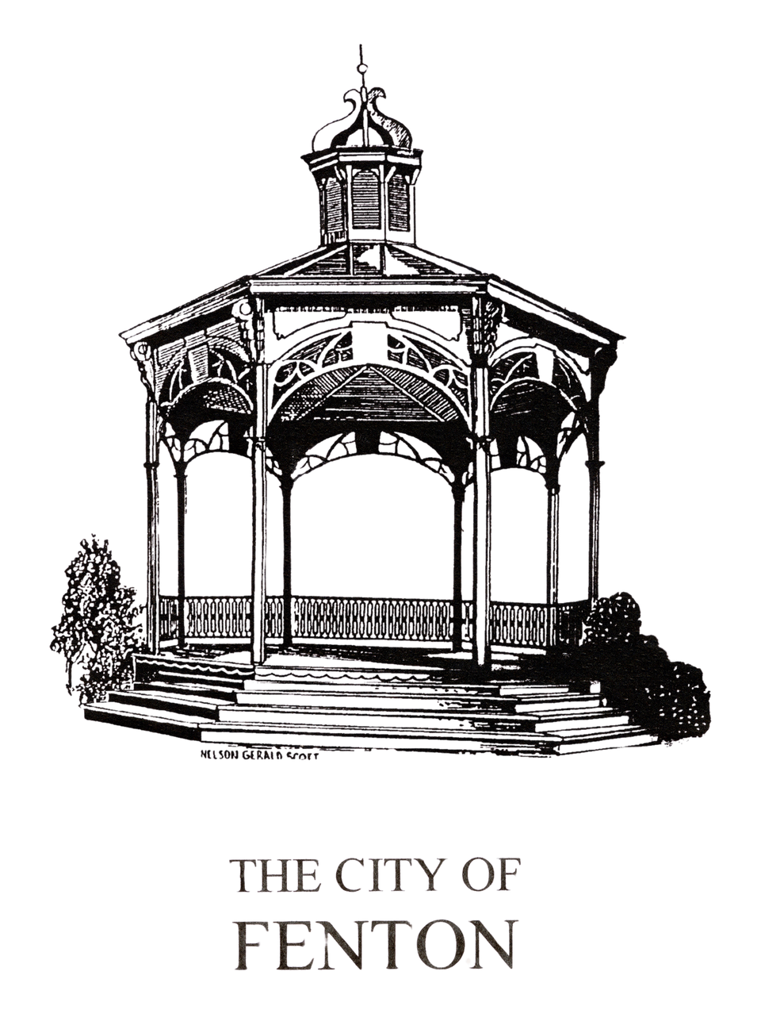
CITY OF
FENTON
Community Center Parking Lot Redevelopment Project
FENTON CITY COUNCIL AND
DOWNTOWN DEVELOPMENT AUTHORITY
JOINT MEETING
MARCH 25, 2026
7:00PM
FENTON COMMUNITY AND CULTURAL CENTER

Slide 2
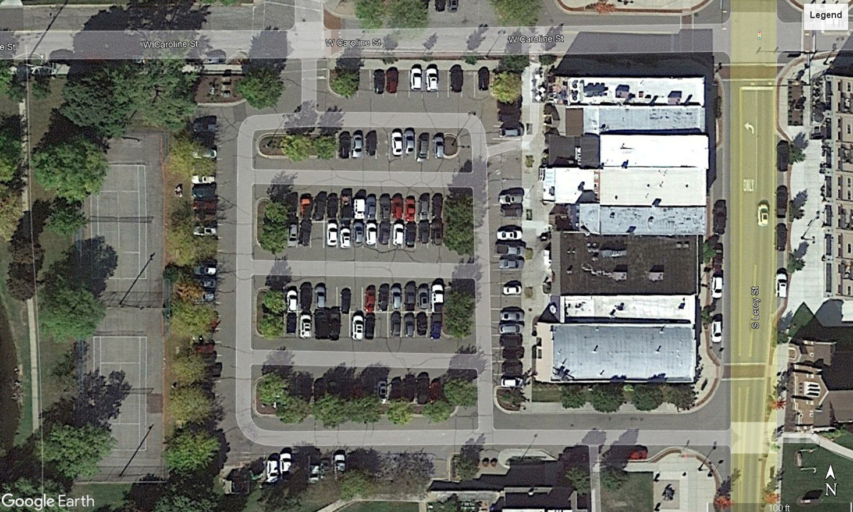



B-21
B-06
B-11
B-16
B-01
B-02
B-07
B-12
B-17
B-03
B-08
B-13
B-18
B-09
B-14
B-19
B-22
B-04
B-15
B-20
B-05
B-10
B-23
Legend
Soil Boring Location Plan
Proposed FentonDevelopment
Caroline Street and Leroy Street Fenton, Michigan
Soil Borings performed by Triple R Drilling on March 18, 19, 21, 22, 23, 24, 28, 29, and April 1, 3, 4, 29, 2024
Project No. 230781 Drawn by: JMH
Date: 5/23/24
Plate
No. 2
Scale: NTS

Slide 3


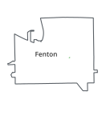

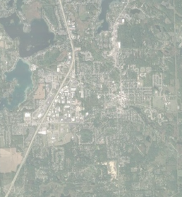

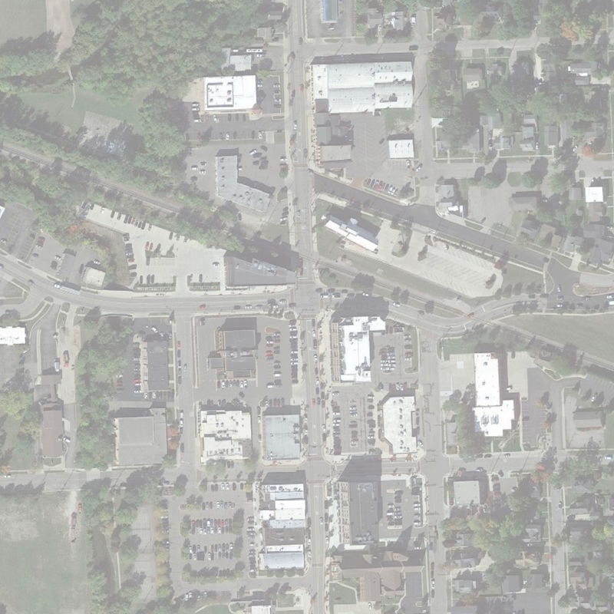
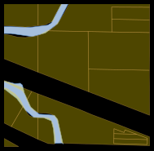



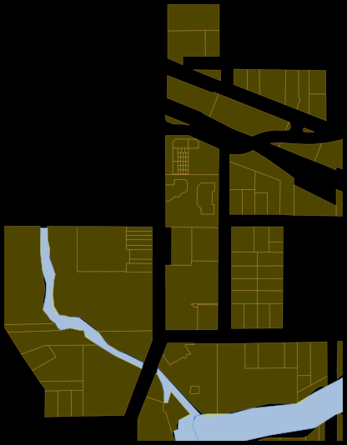








































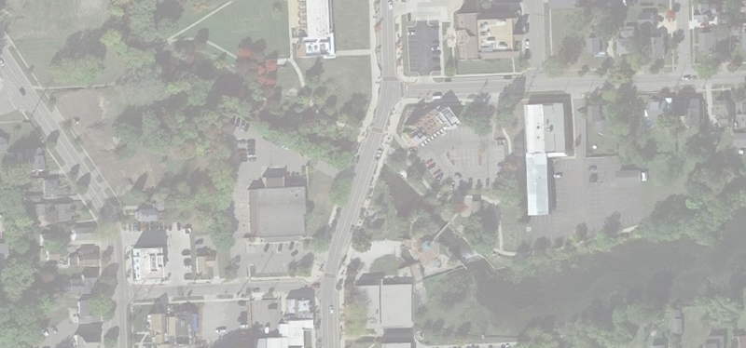

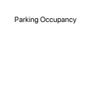













Page 10 of 24

Slide 4

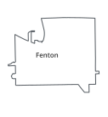




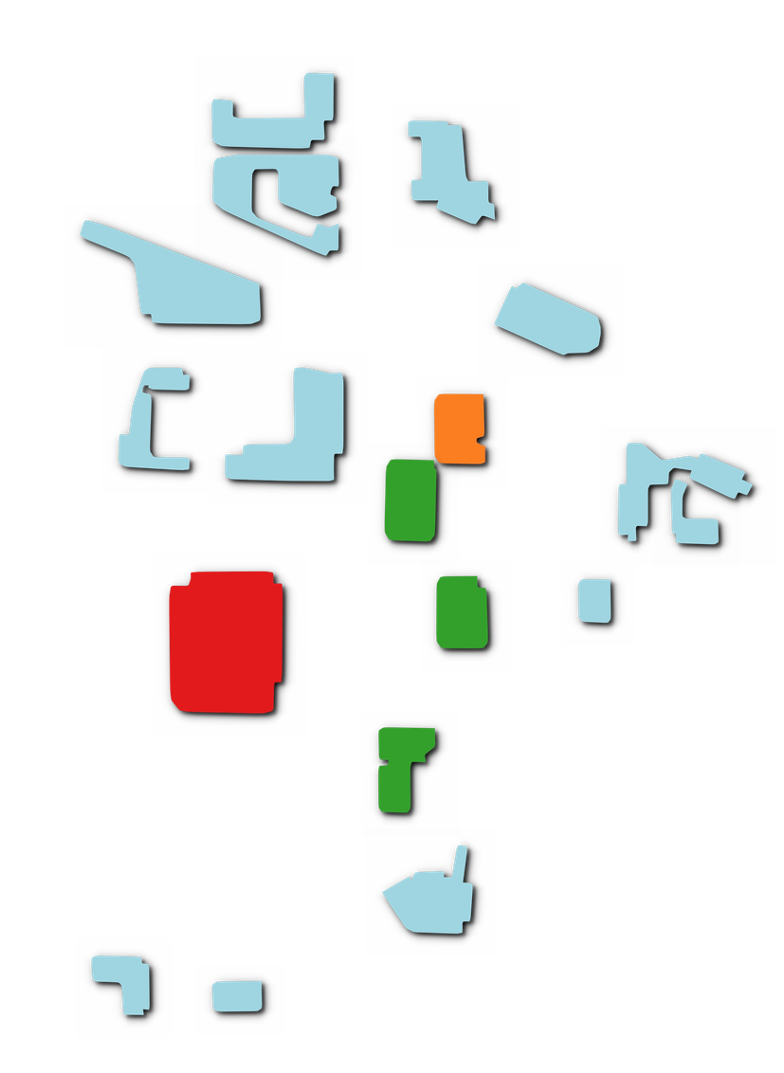

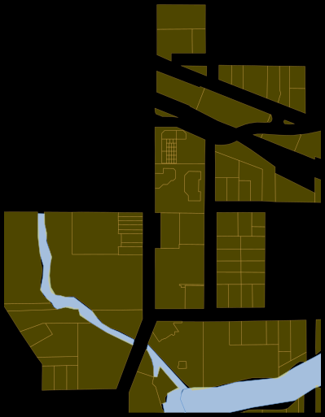




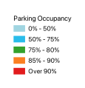
Page 13 of 24

Slide 5

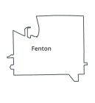
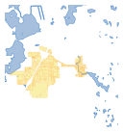



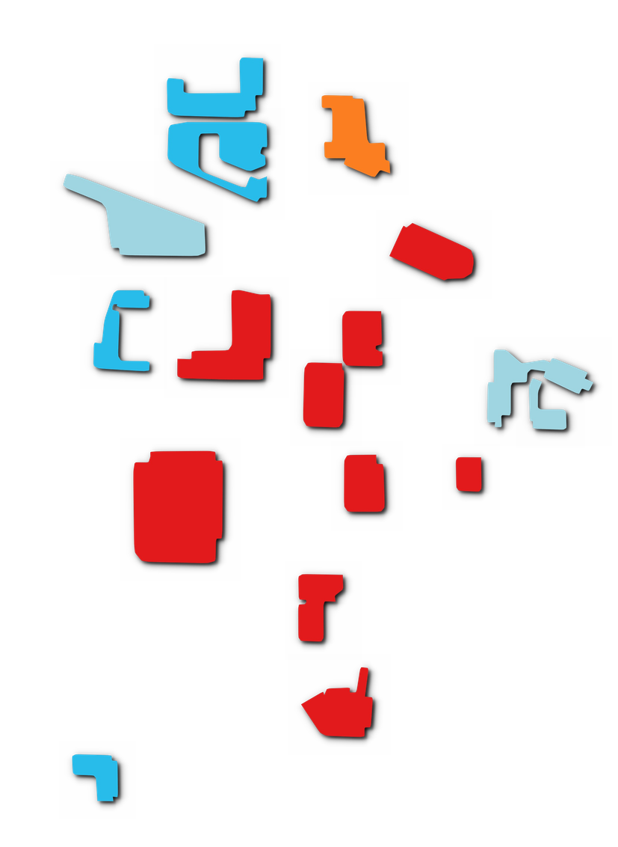





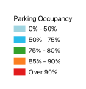
Page 17 of 24

Slide 6
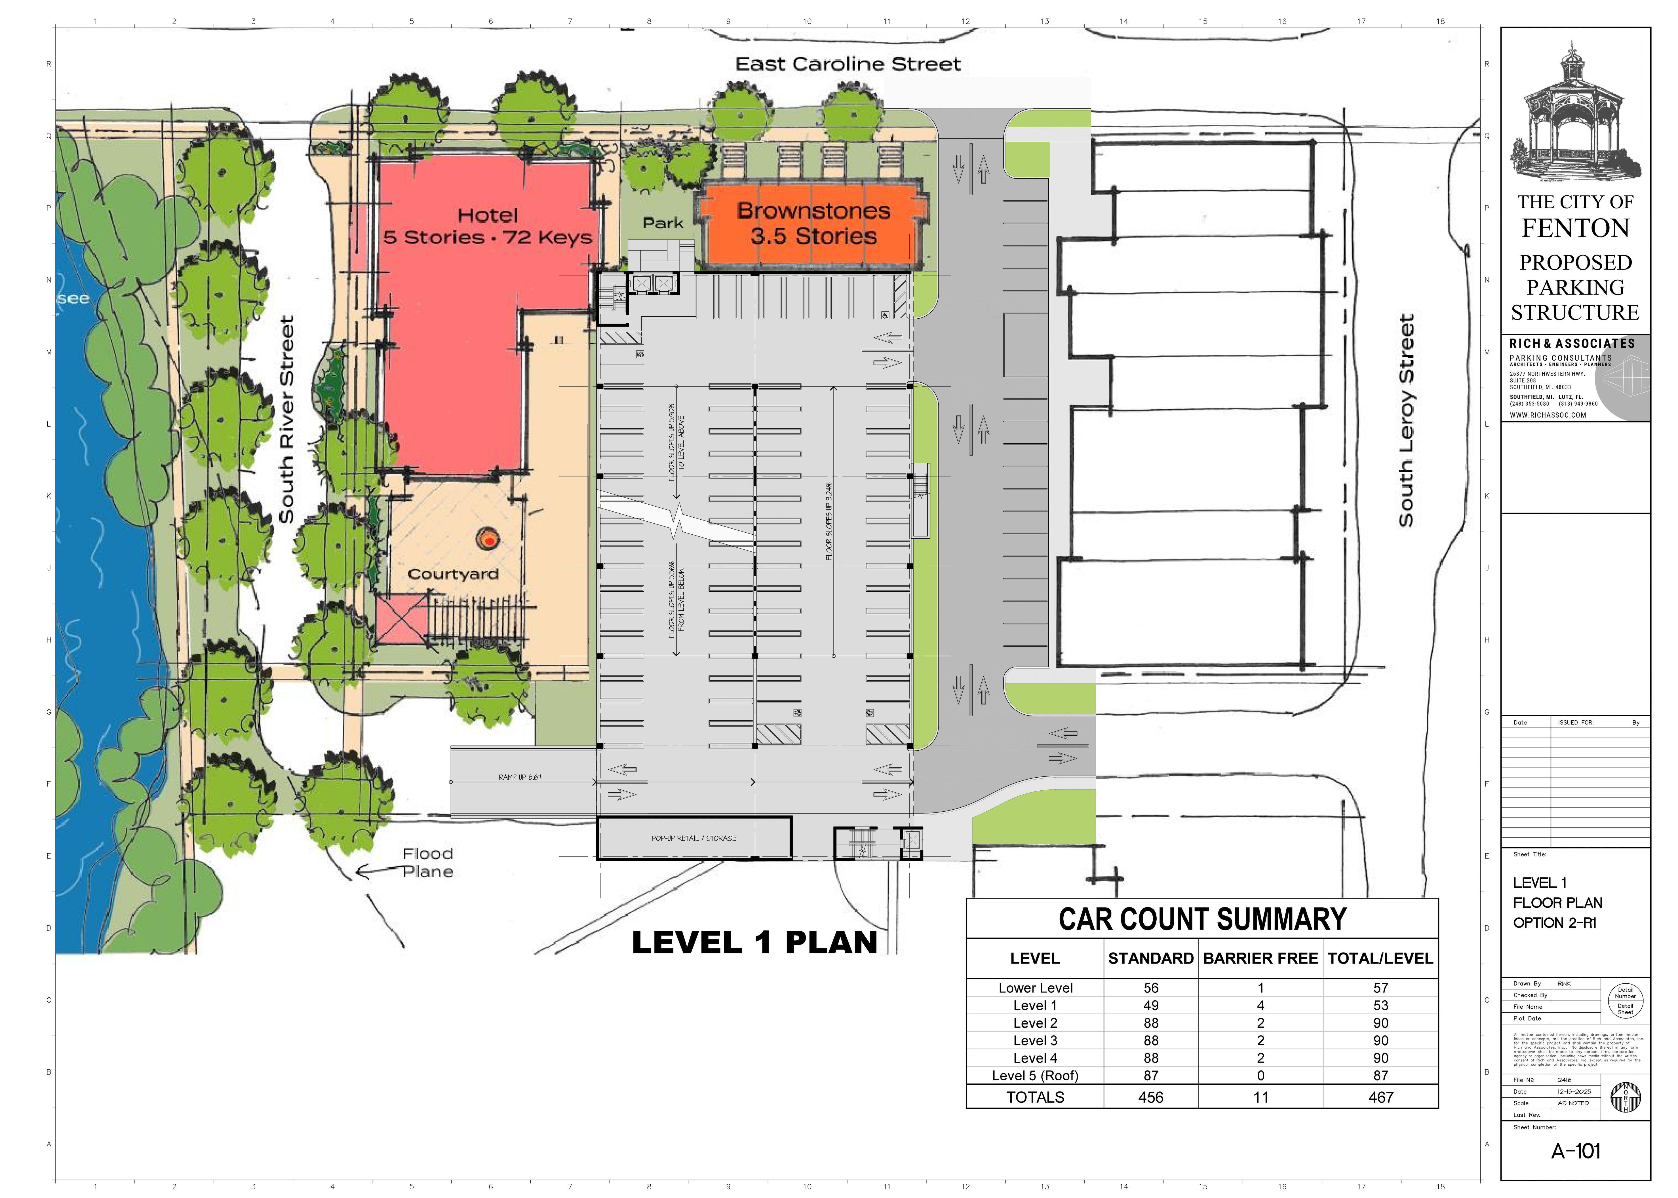

Slide 7
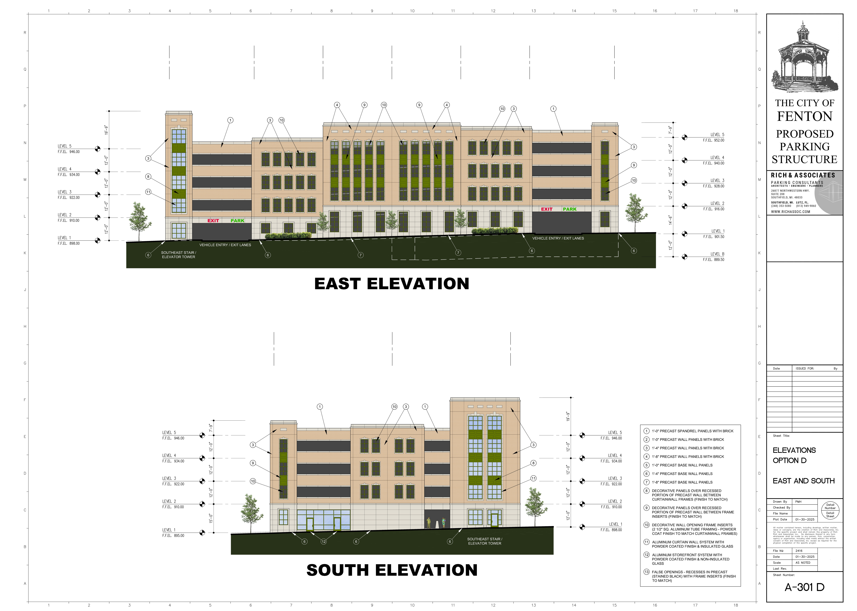

Slide 8
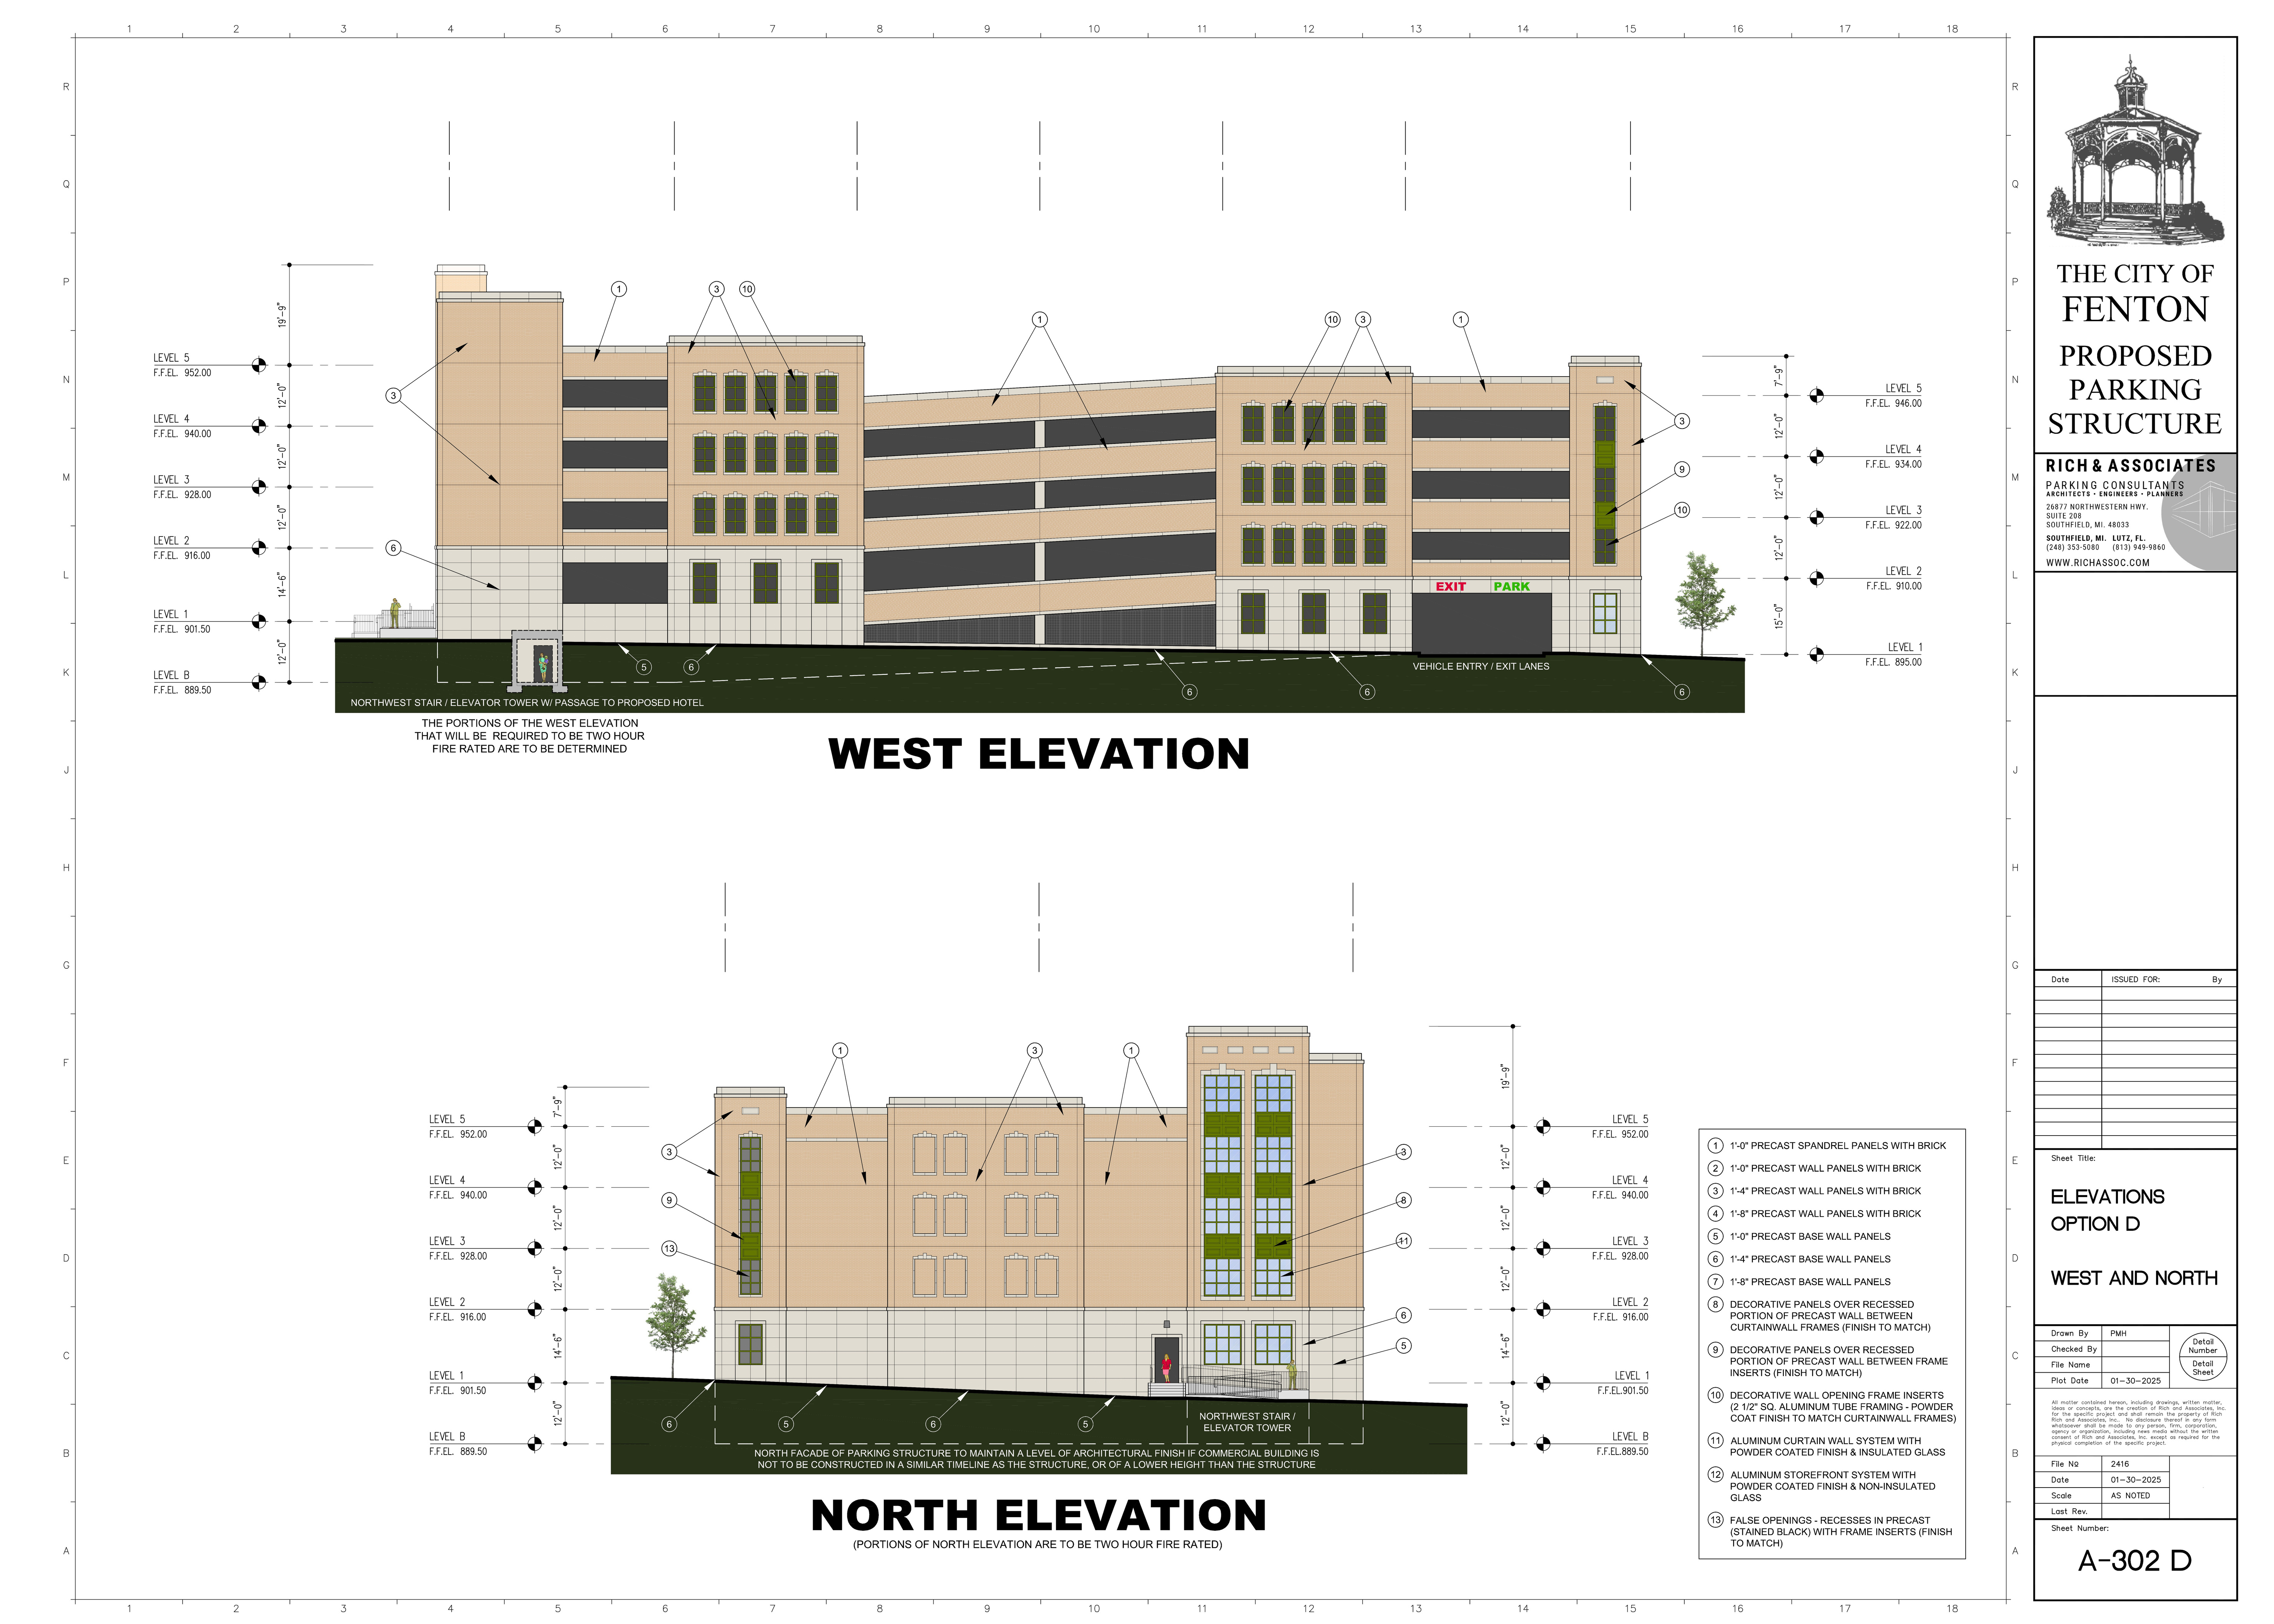

Slide 9
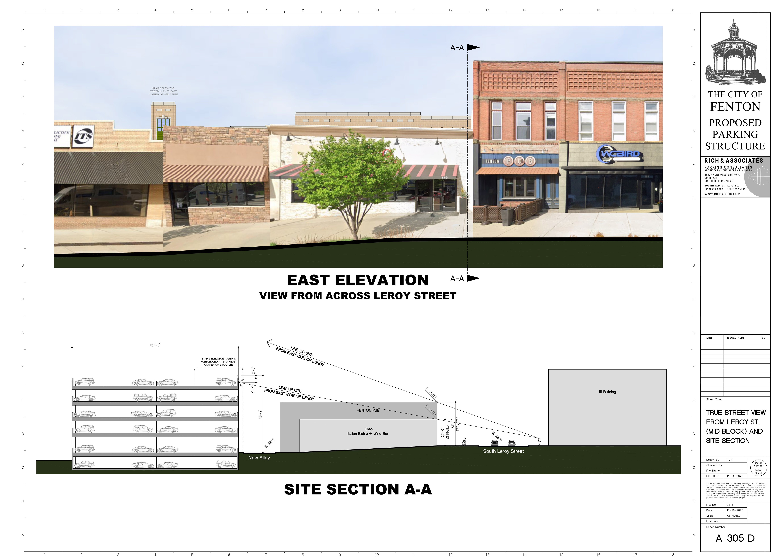

Slide 10
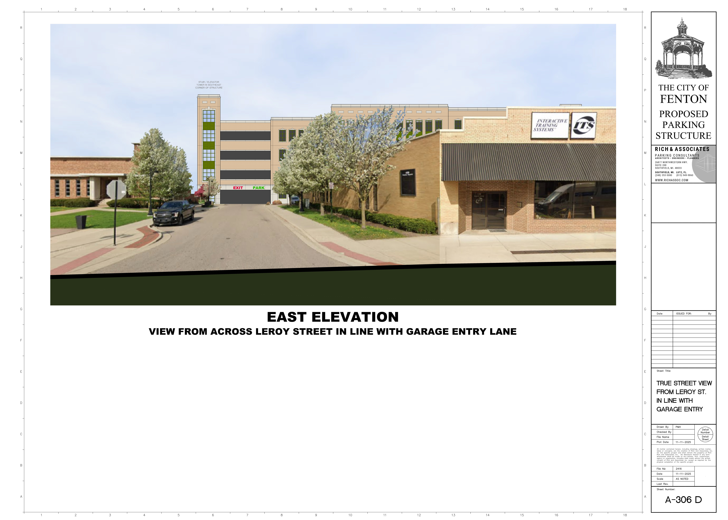

Slide 11
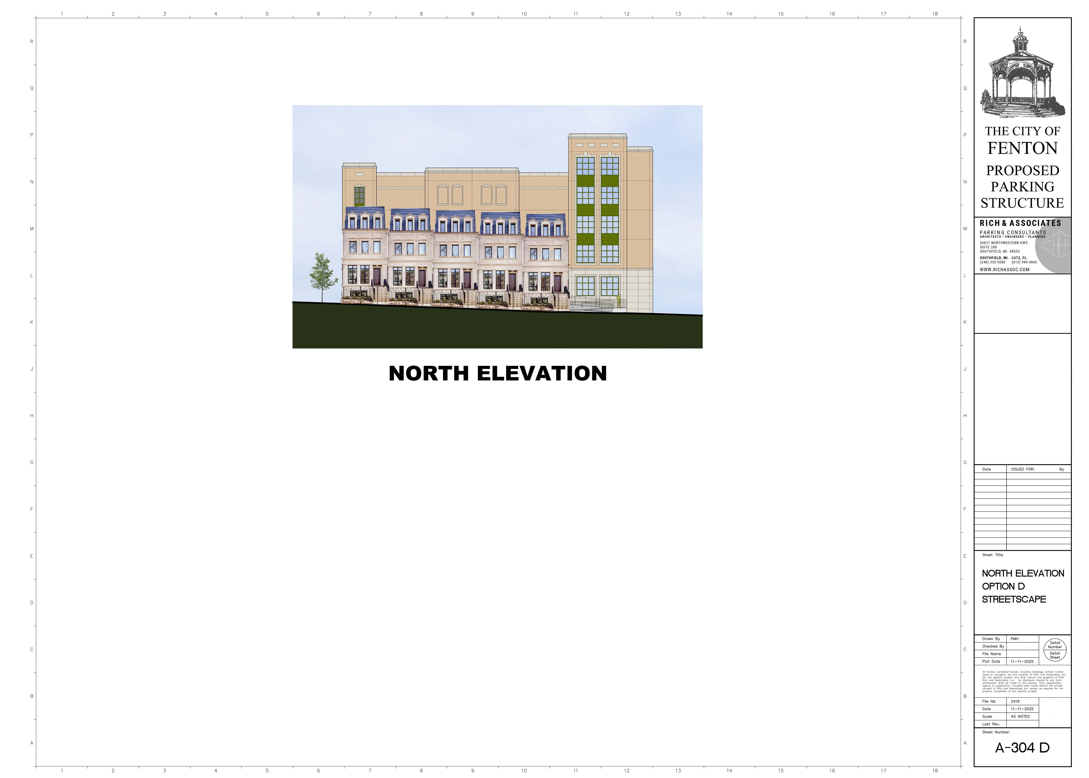

Slide 12
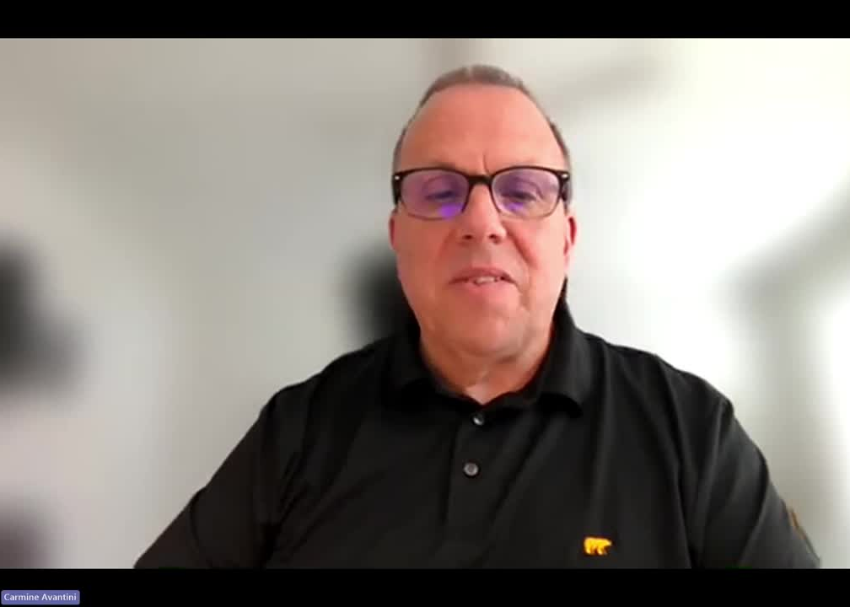

Slide 13
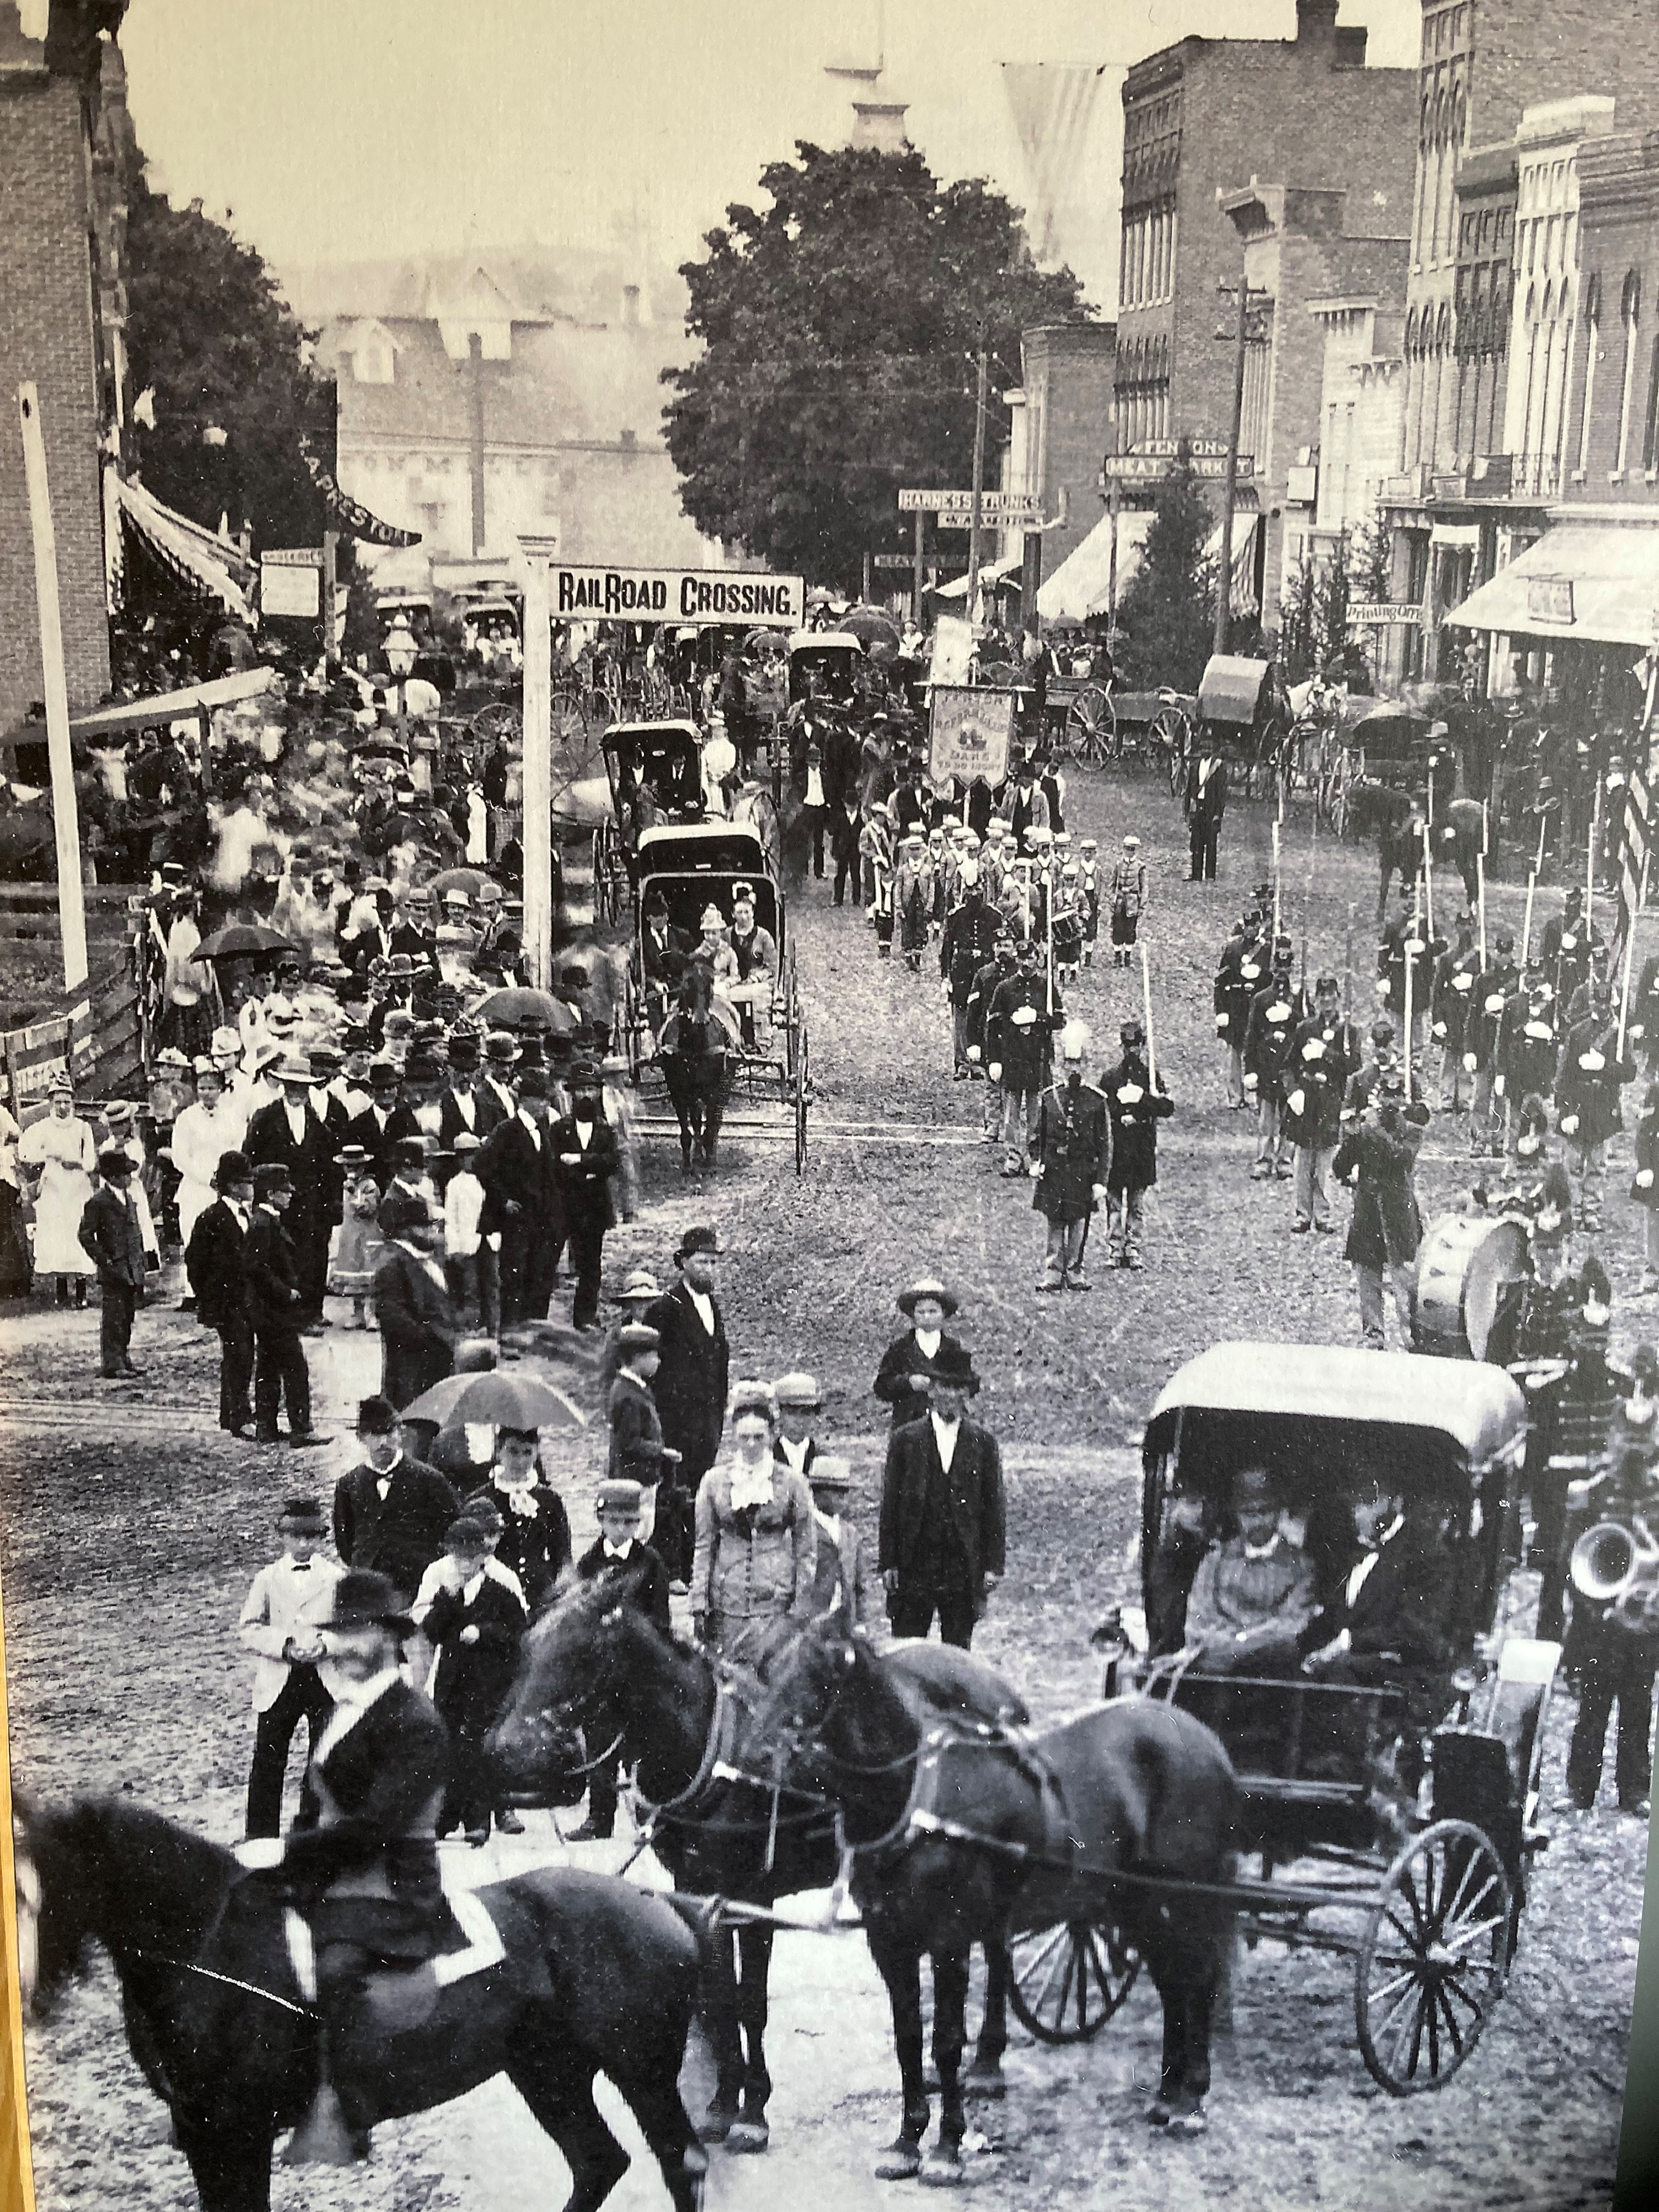

Slide 14
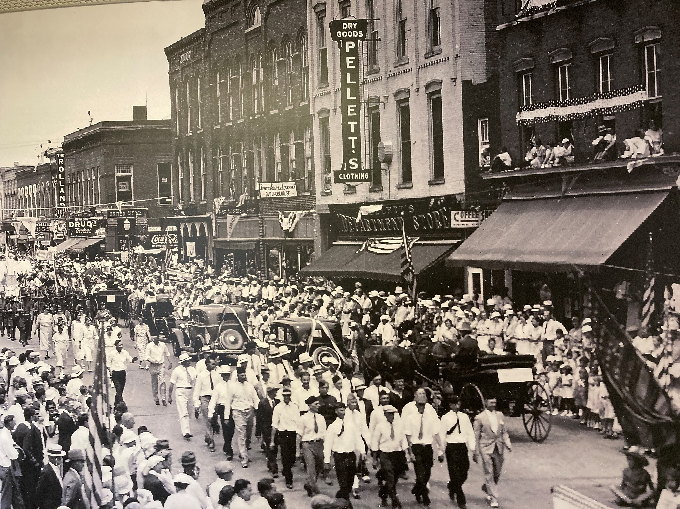

Slide 15
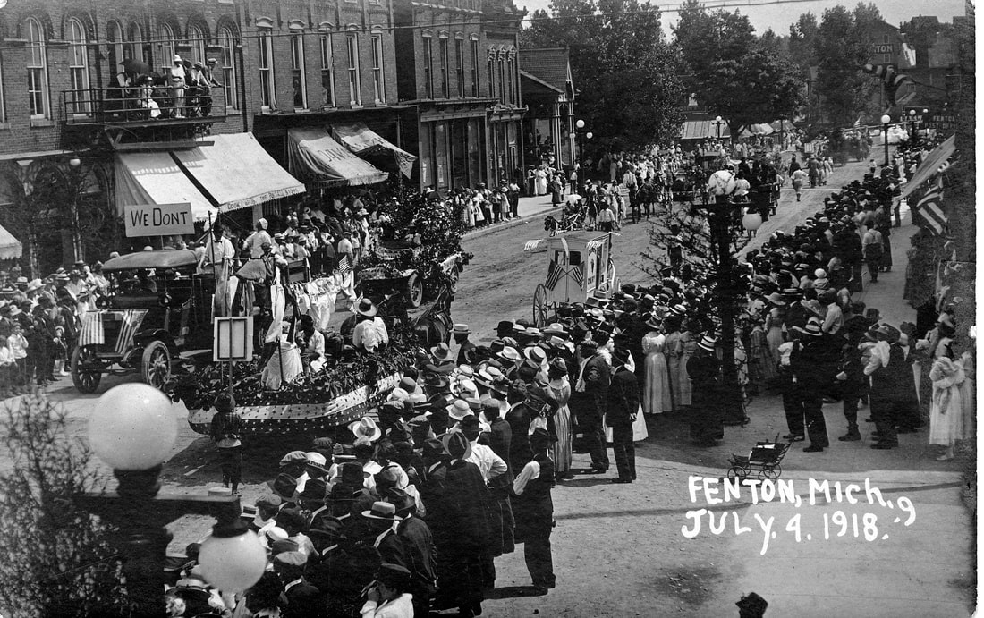

Slide 16
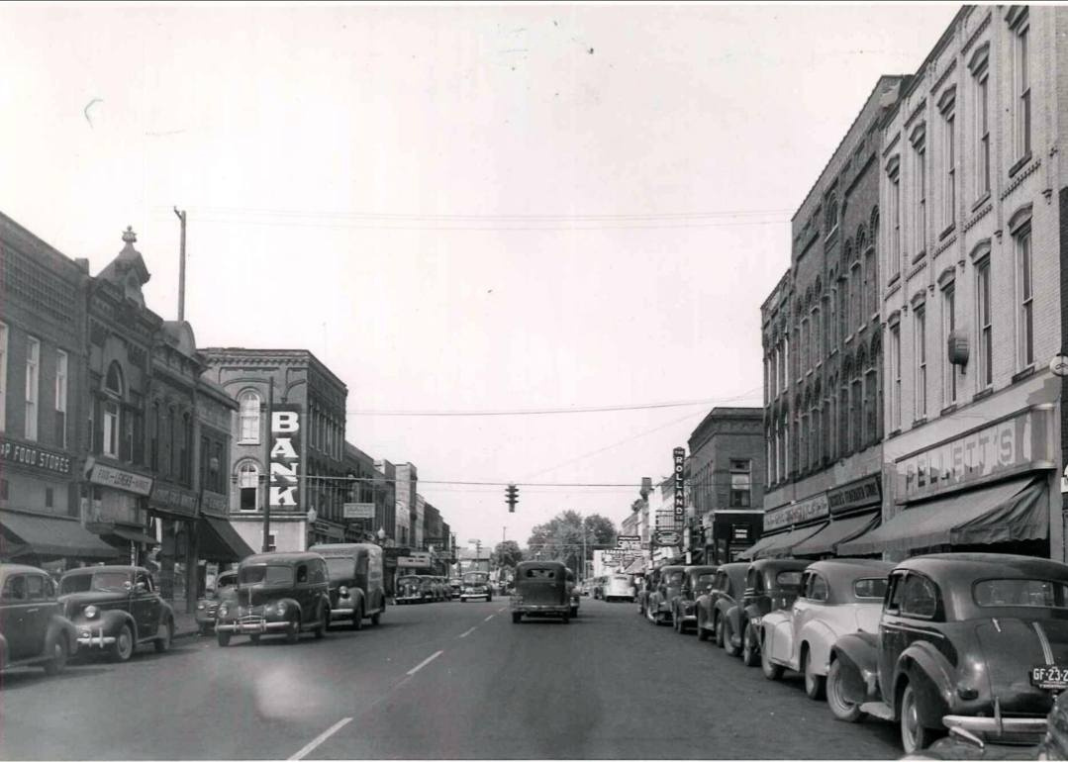

Slide 17
PUBLIC
Q&A
Community Center Parking Lot Redevelopment Project
FENTON CITY COUNCIL AND
DOWNTOWN DEVELOPMENT AUTHORITY
JOINT MEETING
MARCH 25, 2026
7:00PM
FENTON COMMUNITY AND CULTURAL CENTER

